Slide 1
Sports Buddy Finder UML Diagrams
Sports Buddy Team
October 24, 2014

Slide 2
Features
Sign Up
Login
Edit Profile
Forgot Password
Create Event
Join Current Events
View Calendar
Invite People

Slide 3
Diagrams
Class Diagram For All Features
Use Case Diagram For All Features
Component Diagram For All Features
Layer Diagram For All Features
Activity Diagrams For Each Feature
Sequence Diagrams For Each Feature

Slide 4
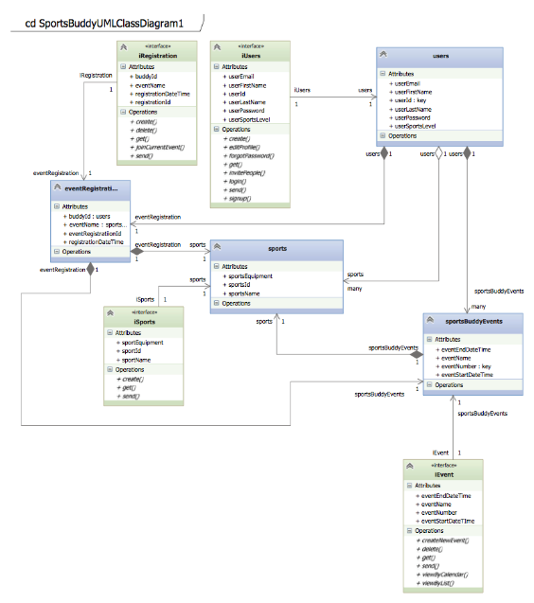
Class Diagram For All Features

Slide 5
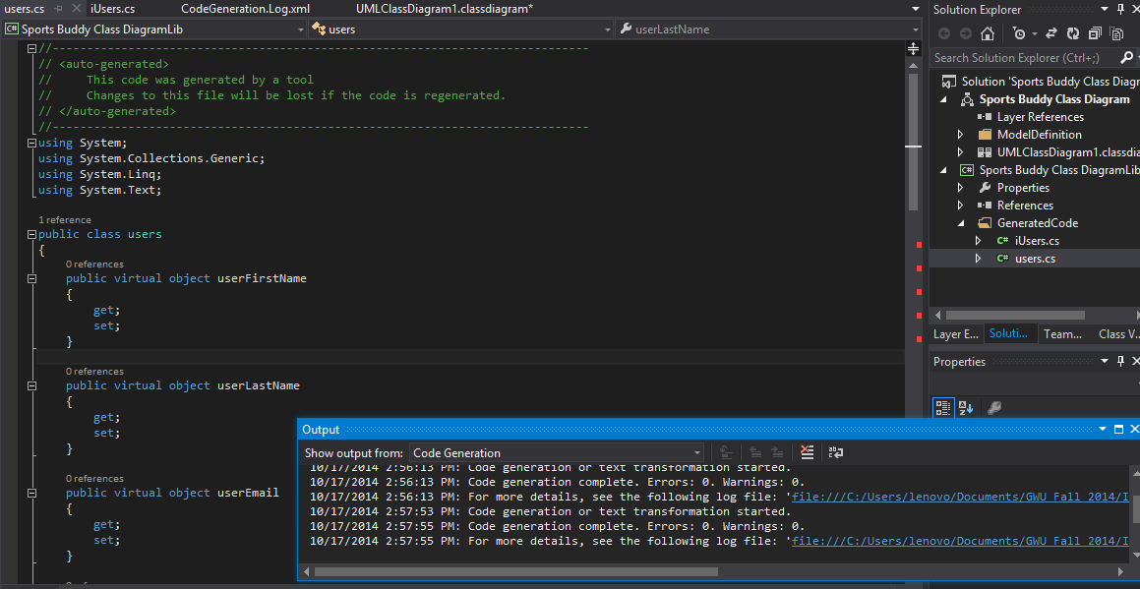
User Class Code Generate

Slide 6
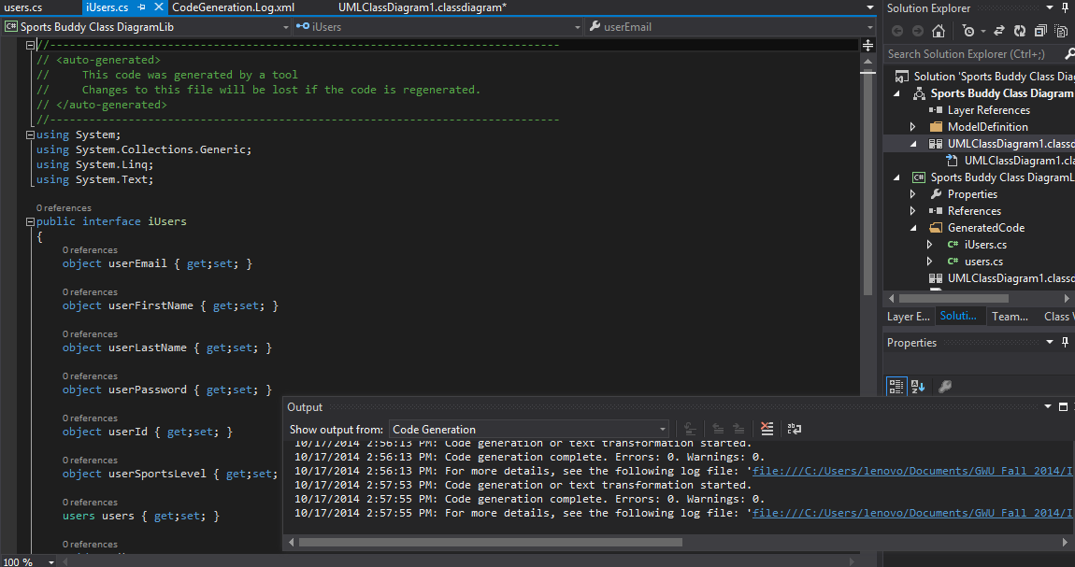
iUser Interface Code Generate

Slide 7
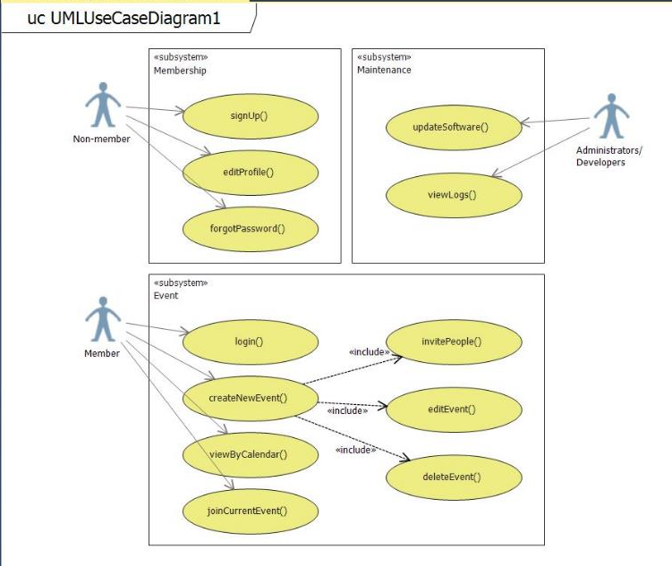
Use Case For All Features

Slide 8
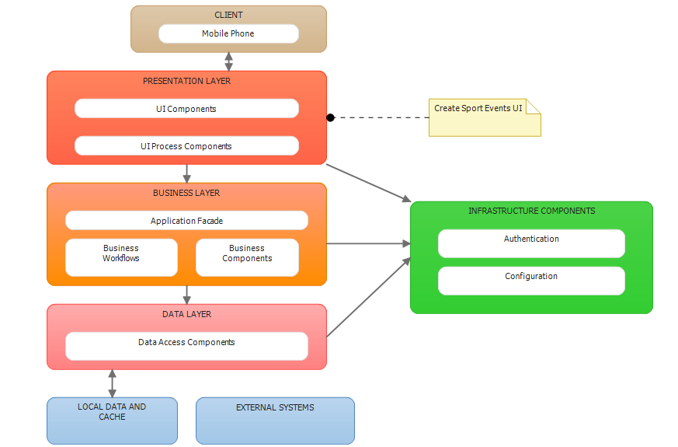
Layer Diagram For All Features

Slide 9
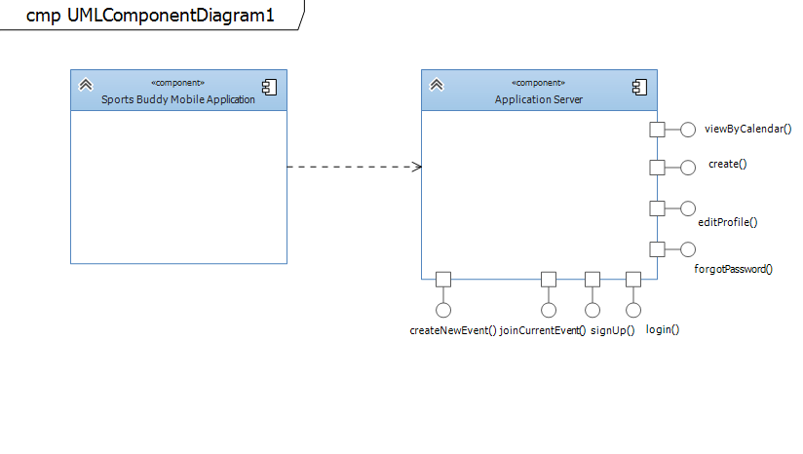
Component Diagram For All Features

Slide 10
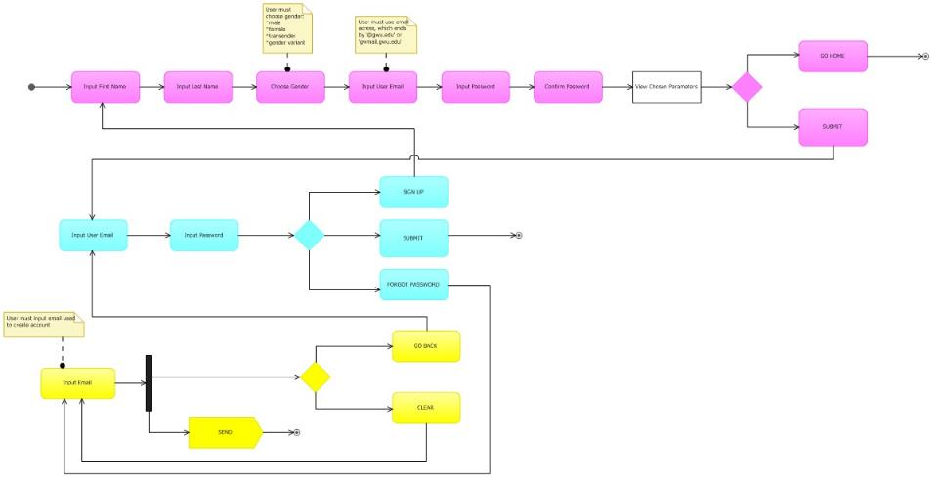
Activity Diagram For Sign Up Feature

Slide 11
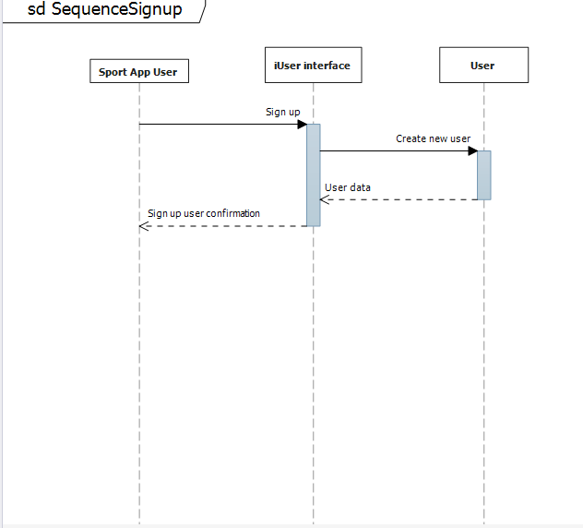
Sequence Diagram For Sign Up Feature

Slide 12
Activity Diagram For Login Feature

Slide 13
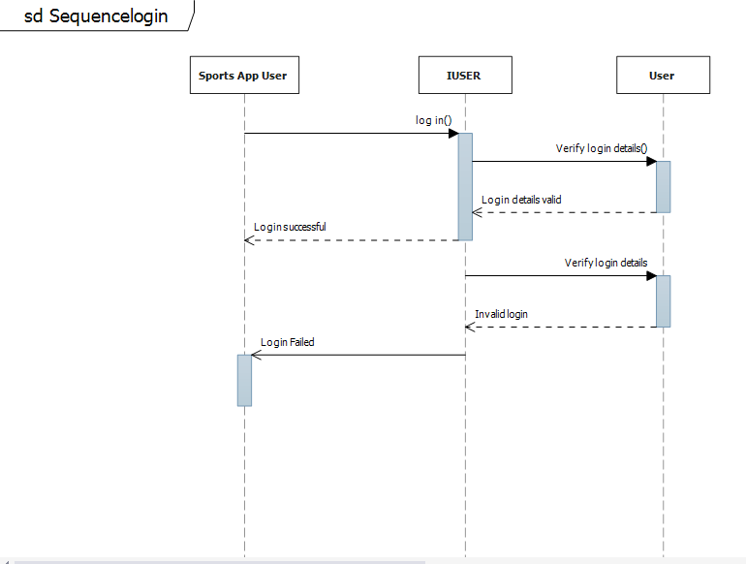
Sequence Diagram For Login Feature

Slide 14
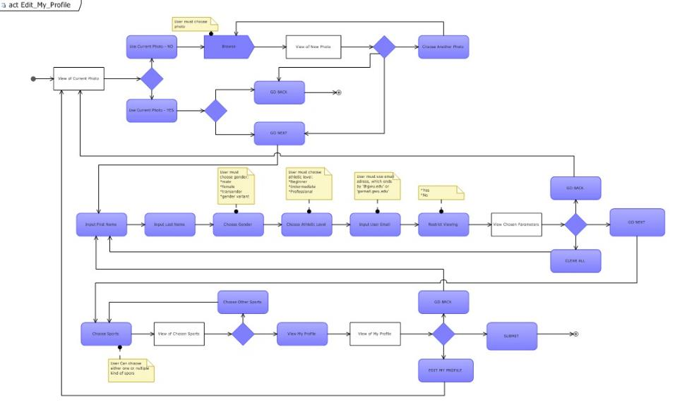
Activity Diagram For Edit Profile Feature

Slide 15
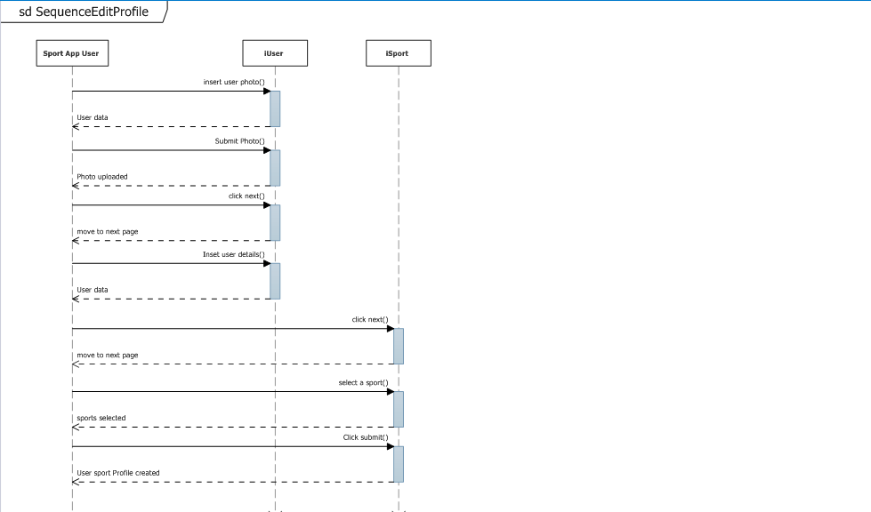
Sequence Diagram For Edit Profile Feature

Slide 16
Activity Diagram For Forgot Password Feature

Slide 17
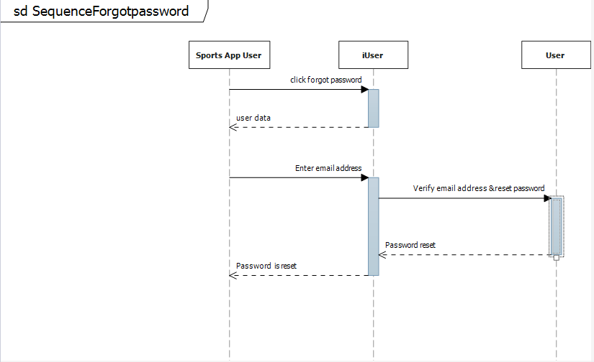
Sequence Diagram For Forgot Password Feature

Slide 18
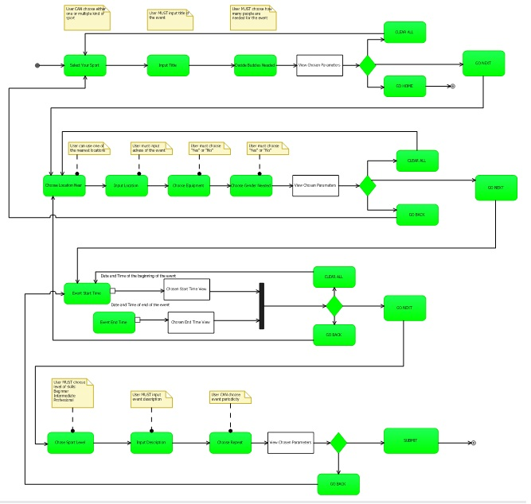
Activity Diagram For Create Event Feature

Slide 19
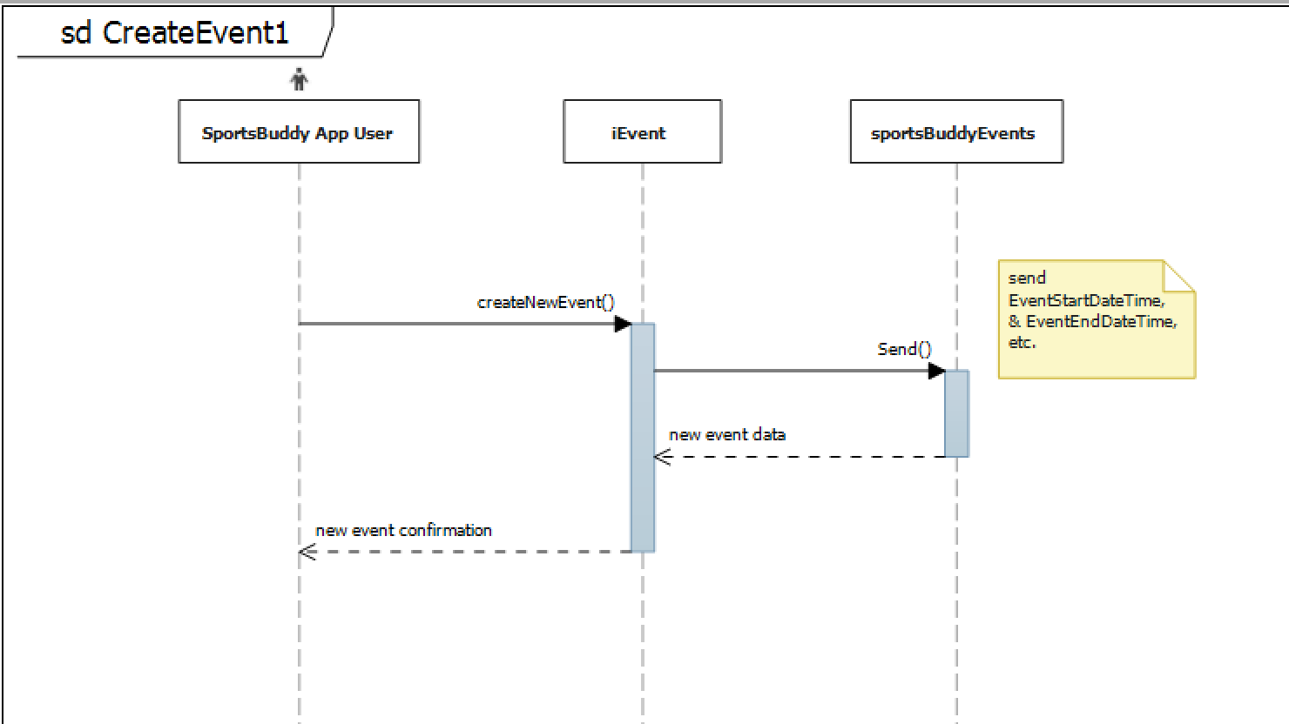
Sequence Diagram For Create Event Feature

Slide 20
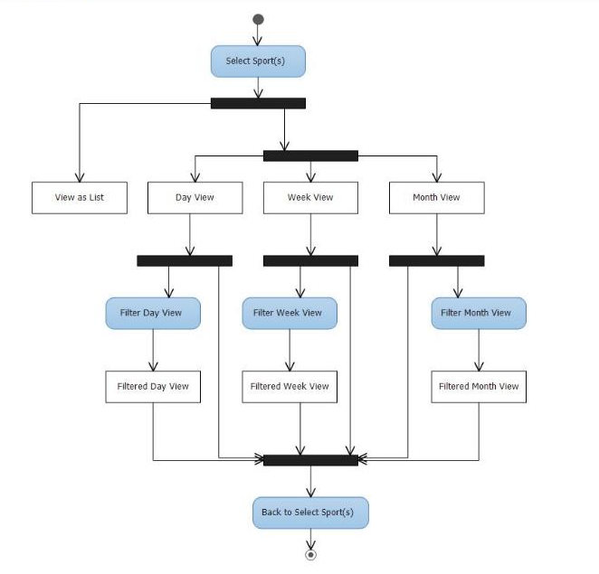
Activity Diagram For View Calendar Feature

Slide 21
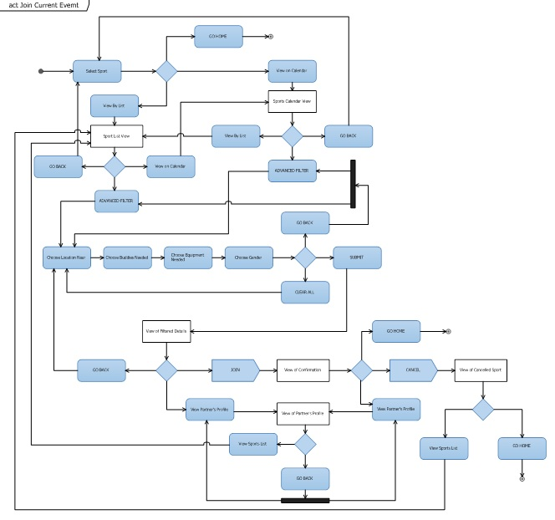
Activity Diagram For Join Current Events Feature

Slide 22
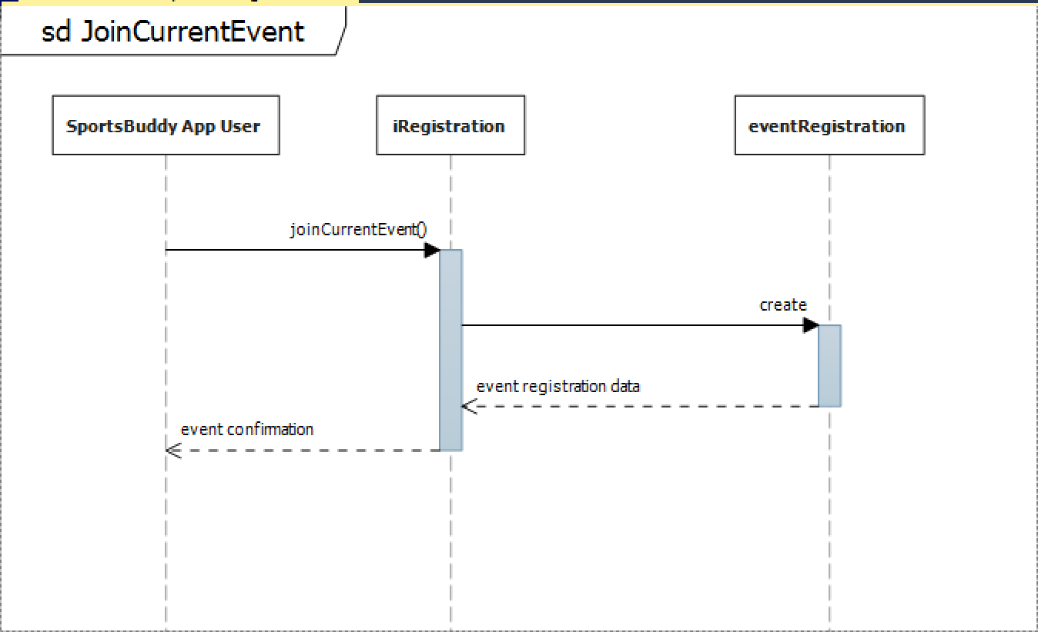
Sequence Diagram For Join Current Events Feature

Slide 23
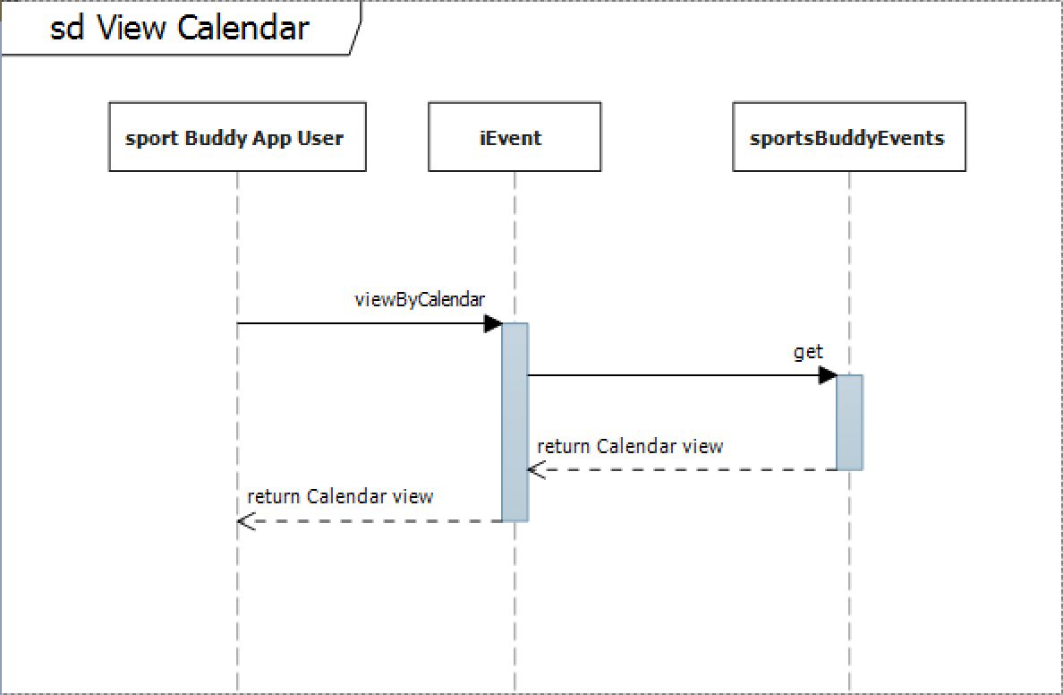
Sequence Diagram For View Calendar Feature

Slide 24
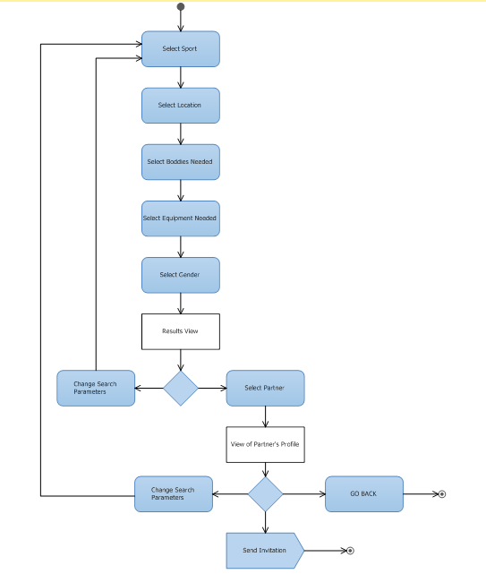
Activity Diagram For Invite People Feature

Slide 25
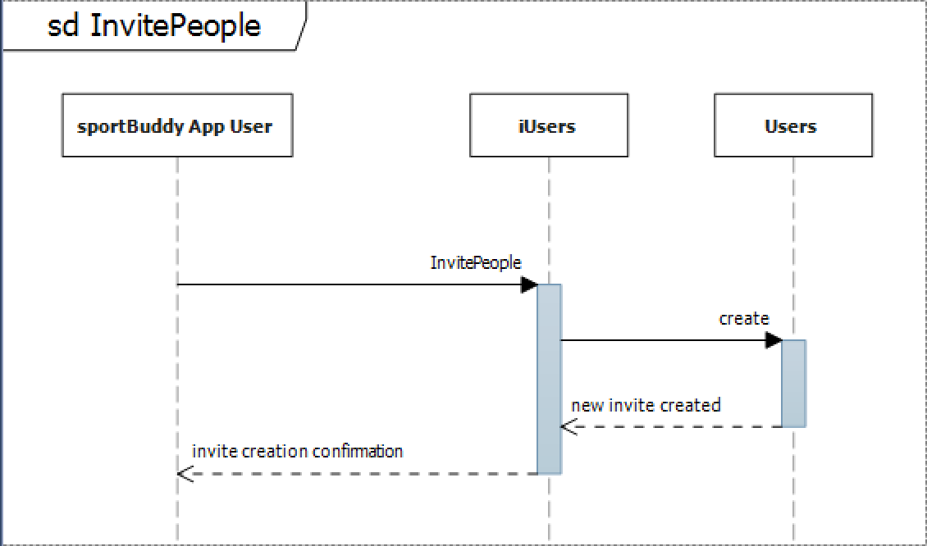
Sequence Diagram For Invite People Feature

